Slide 1
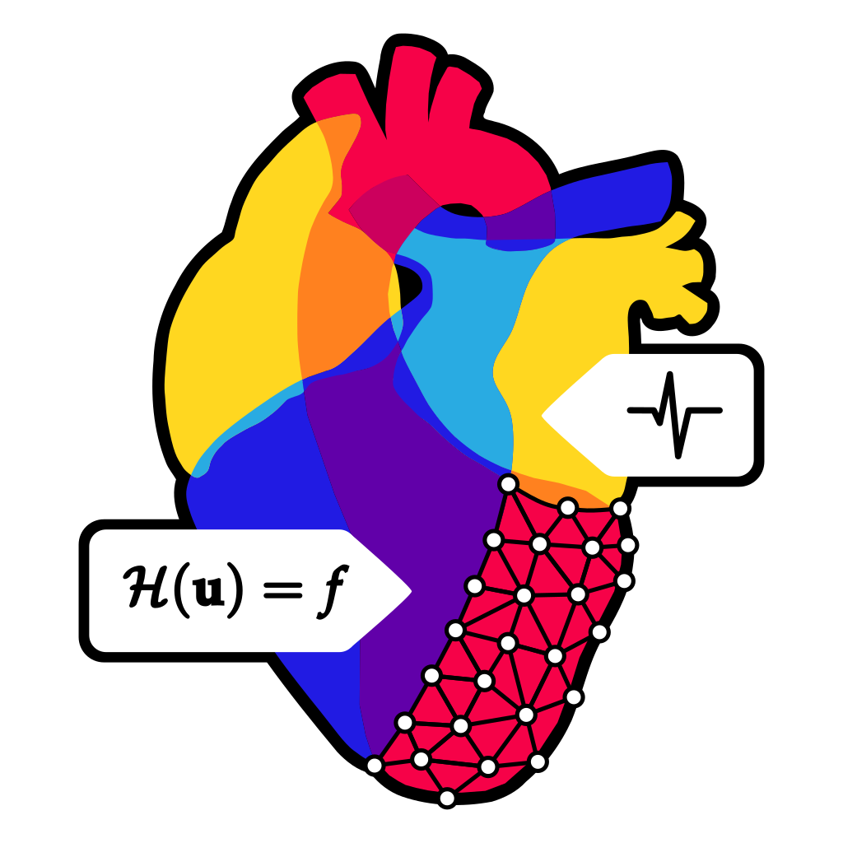





Matrix-free algorithms for cardiac simulations
Andrea Tonini, Junxiang Wang, Luca Dede’
8th September 2026

Slide 2
Introduction
  Motivations
  Matrix-free algorithms
3D-0D electromechanical model
  Electrophysiology model
  Cardiac mechanical model
  0D circulatory model
Poromechanics model
Conclusions and future developments

Slide 3
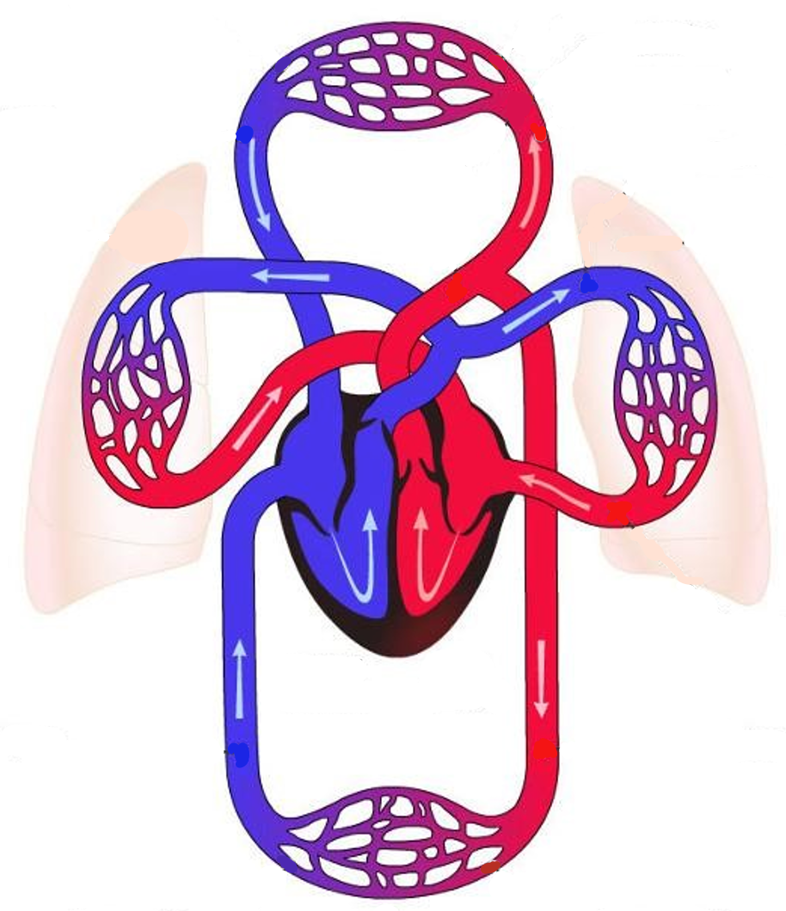
Cardiac modeling
LEFT HEART:
Atrium
Ventricle
PULMONARY
CIRCULATION
World Health Organization: cardiovascular diseases are the leading cause of death globally
Hypertension
Atrial fibrillation
Congenital heart defects
Covid-19
Simulate accurately the cardiovascular system by means of physics-based mathematical models, in an HPC enviroment
RIGHT HEART:
Atrium
Ventricle
SYSTEMIC
CIRCULATION

Slide 4
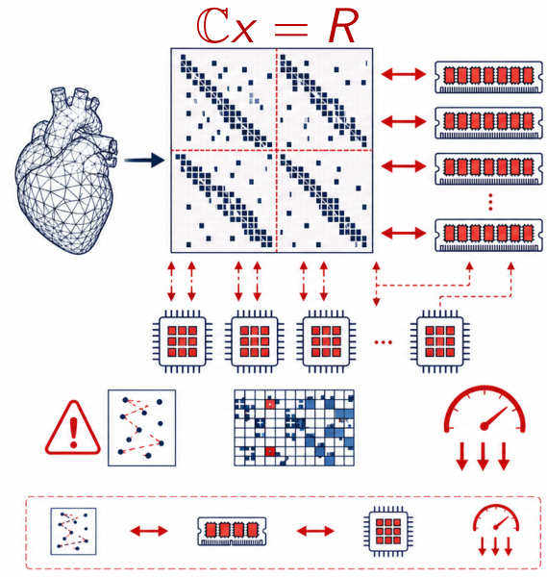
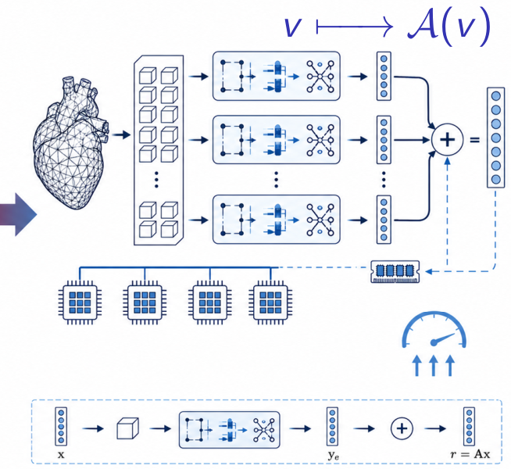
Matrix-based vs matrix-free
Matrix-based
Matrix-free
System matrix
Assemble and store
System matrix
Do not store any matrix
Matrix-vector product
Use stored matrix entries
Matrix-vector product
Compute the matrix
action on the fly
Time per iteration
High number of
communications between
processors
Time per iteration
Repetitions of the
same computations
Scalability
Limited by memory accesses
Scalability
No limitations given by memory accesses
Update the in-house life^{x} library for running cardiac simulations with matrix-free algorithms
We also updated life^{x} to use SIMD (Single Instruction, Multiple Data) and vectorization
Kronbichler, M. and Kormann, K. (2012)

Slide 5
3D-0D electromechanical model

Slide 6




3D-0D electromechanical model
Matrix-free :work in progress
Cardiac chambers
pressures
Cardiac chambers
pressures
Strains
Strains
Circulation
Electrical
activity
Mechanics
Cardiac chambers
volumes
Cardiac chambers
volumes
Ionic currents
Cardiac
electromechanics
Active tension
Deformed sarcomere length
Potential
Ionic
activity
Force
generation
Calcium
Fedele, M. et al. (2023)

Slide 7
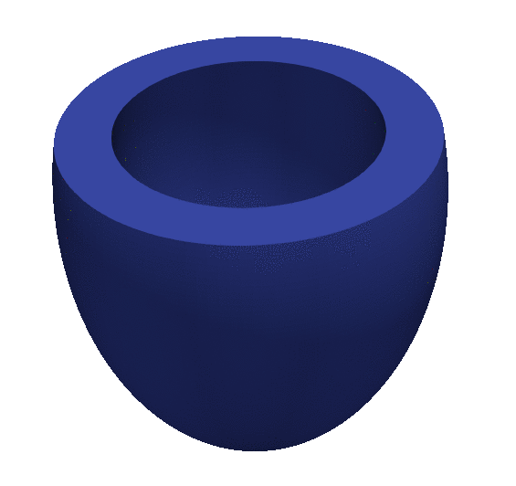
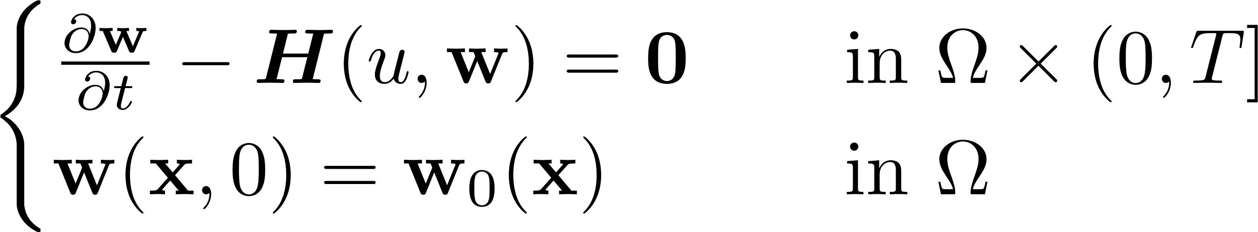
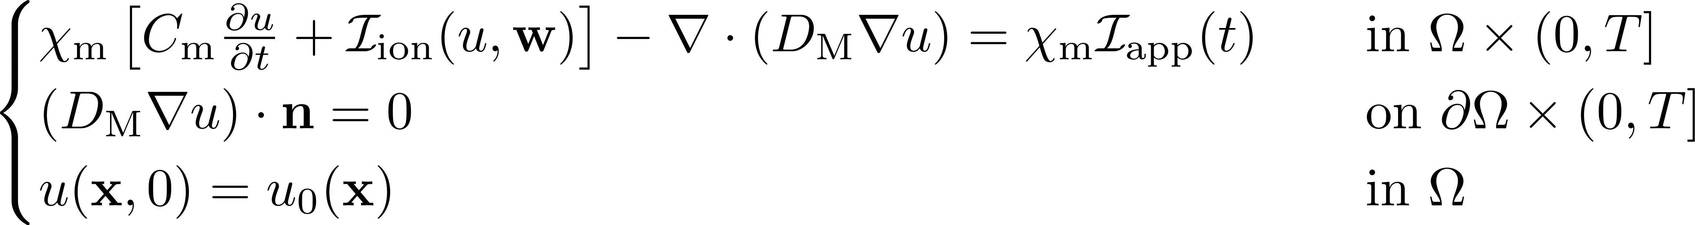
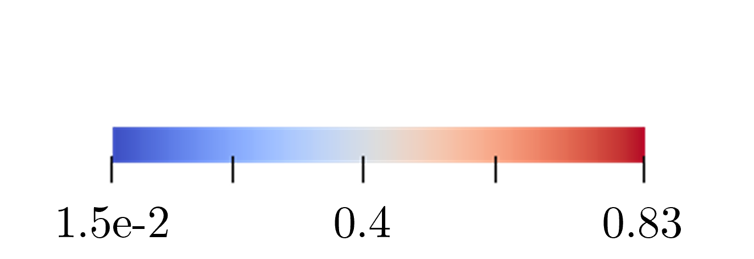

Electrophysiology
Ionic currents
Ionic
activity
Electrical
activity
Potential
Electrophysiology describes cardiac ionic dynamics and electrical propagation
w are the concentrations of ionic species and the gating variables
Ionic model (TTP06¹):
Monodomain model²: u is the unknown transmembrane potential
¹Ten Tusscher, K.H. and Panfilov, A.V. (2006)
²Potse, M. et al. (2006)

Slide 8
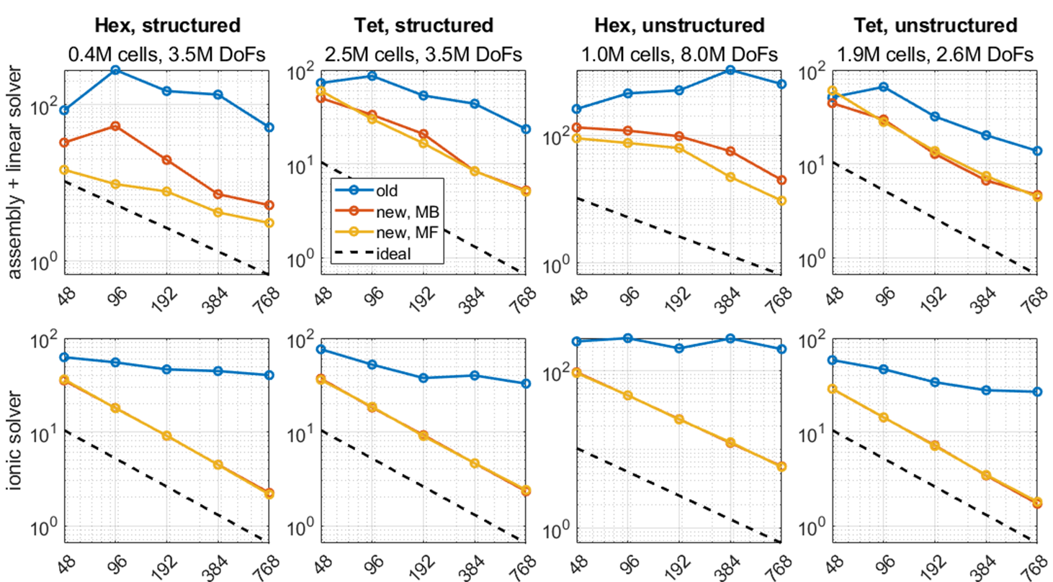
Electrophysiology scalability tests
Solved with CG, tolerance 1e-10, Chebyshev preconditioner
MB: matrix-based
MF: matrix-free
Old: w/o SIMD and vectorization
New: with SIMD and vectorization

Slide 9
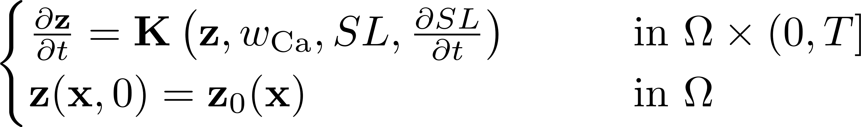
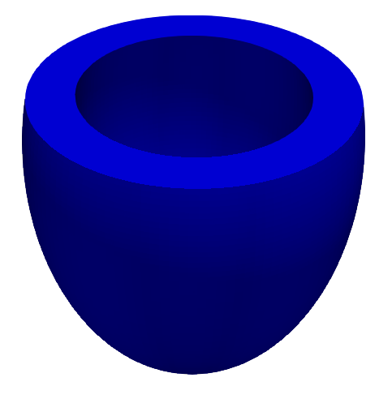

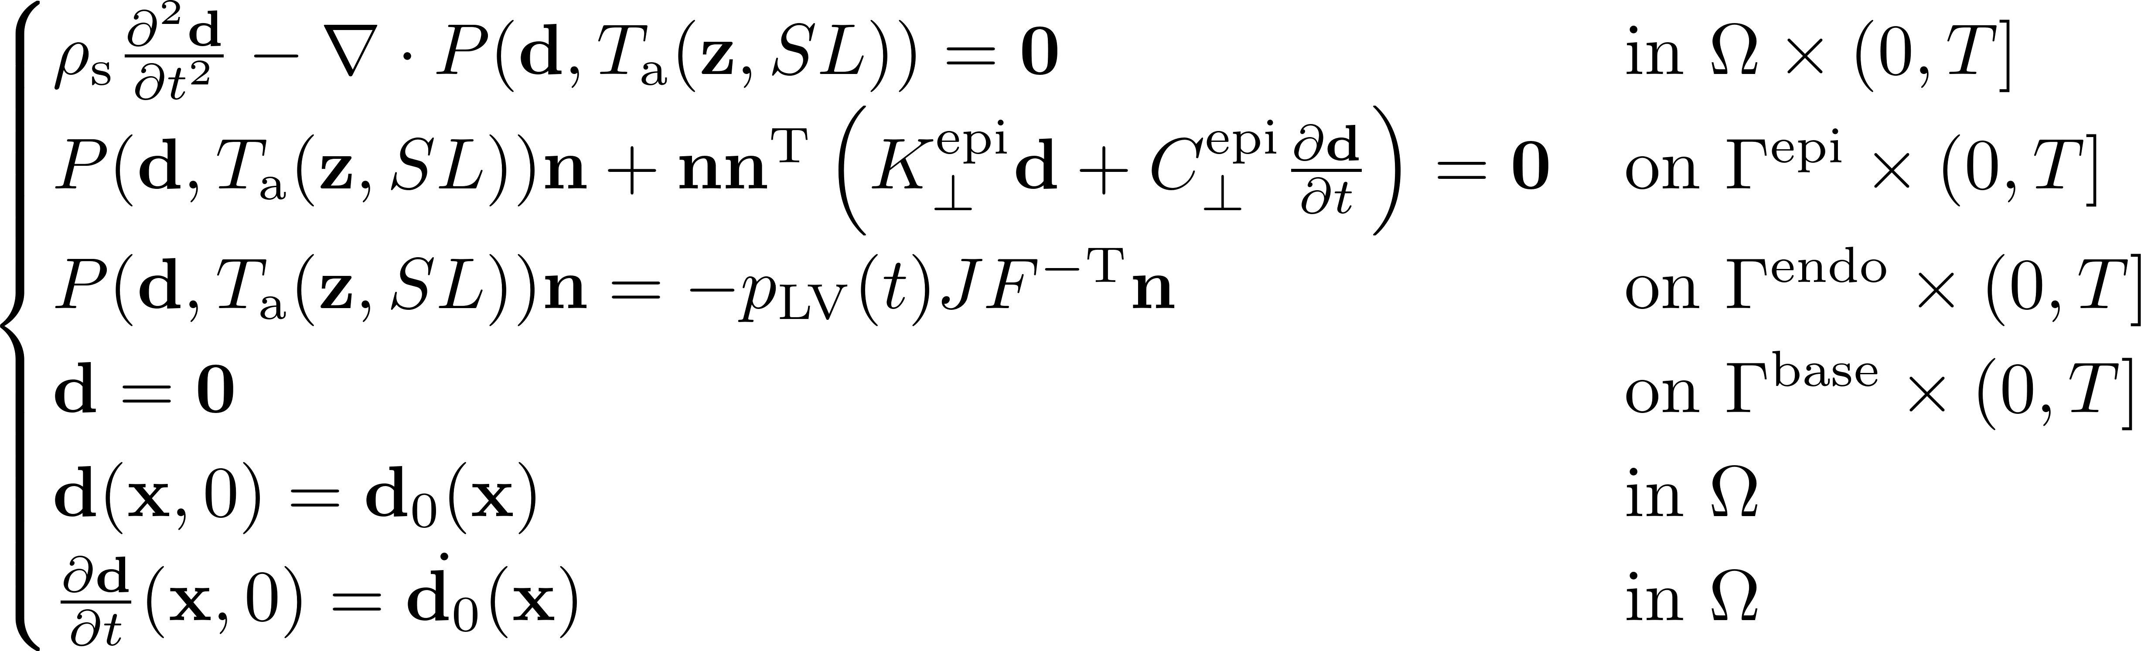


Active force generation and mechanical models
Active tension
Force
generation
Mechanics
Deformed sarcomere length
z are the state variables of the active force generation model used to derive the active tension T_{a}
Active force generation model (RDQ20MF¹):
Mechanical model²: d is the unknown displacement
Deformed sarcomere length (SL)
¹Regazzoni, F., Dede’, L. and Quarteroni, A. (2020)
²Guccione, J.M. and McCulloch, A.D. (1991)

Slide 10
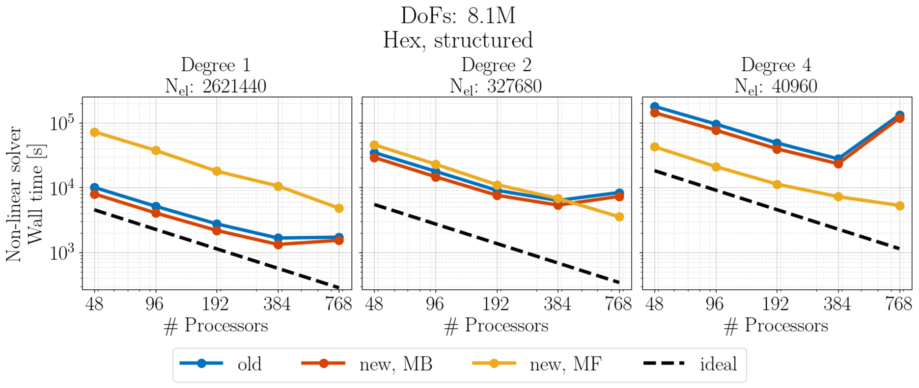
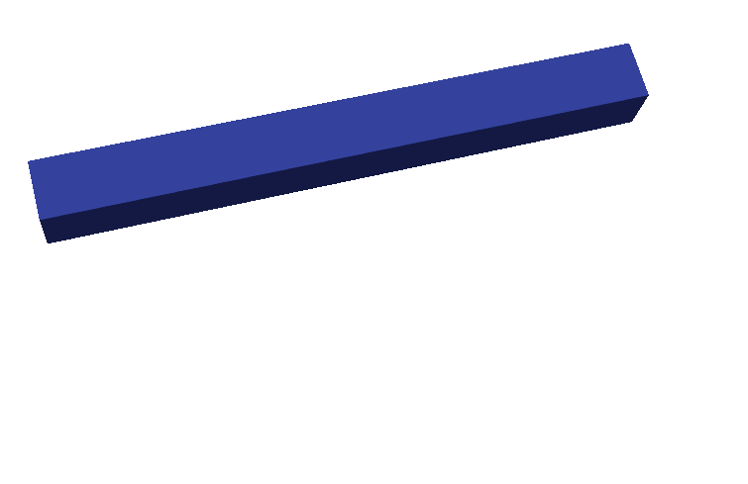
Passive mechanics scalability tests
Solved with GMRES, tolerance 1e-15, Chebyshev preconditioner
MB: matrix-based MF: matrix-free Old: w/o SIMD and vectorization New: with SIMD and vectorization

Slide 11
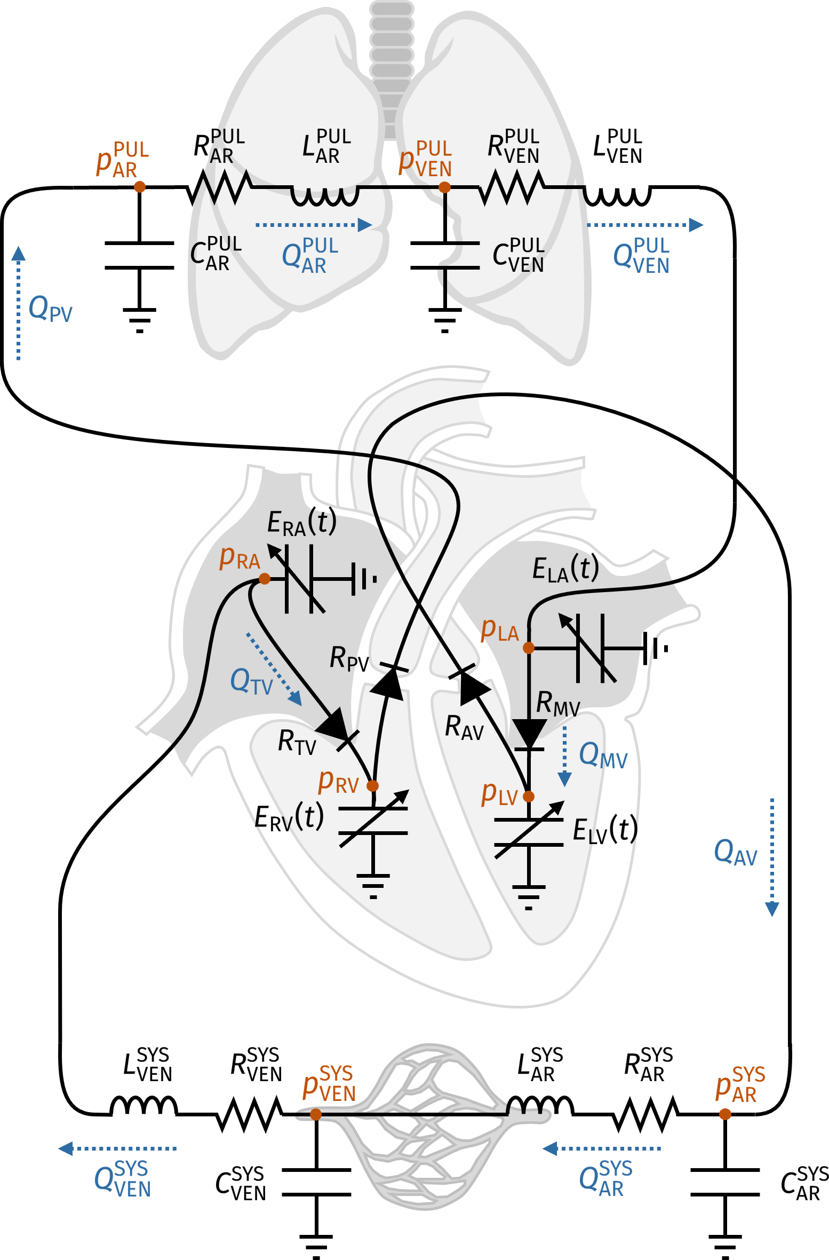
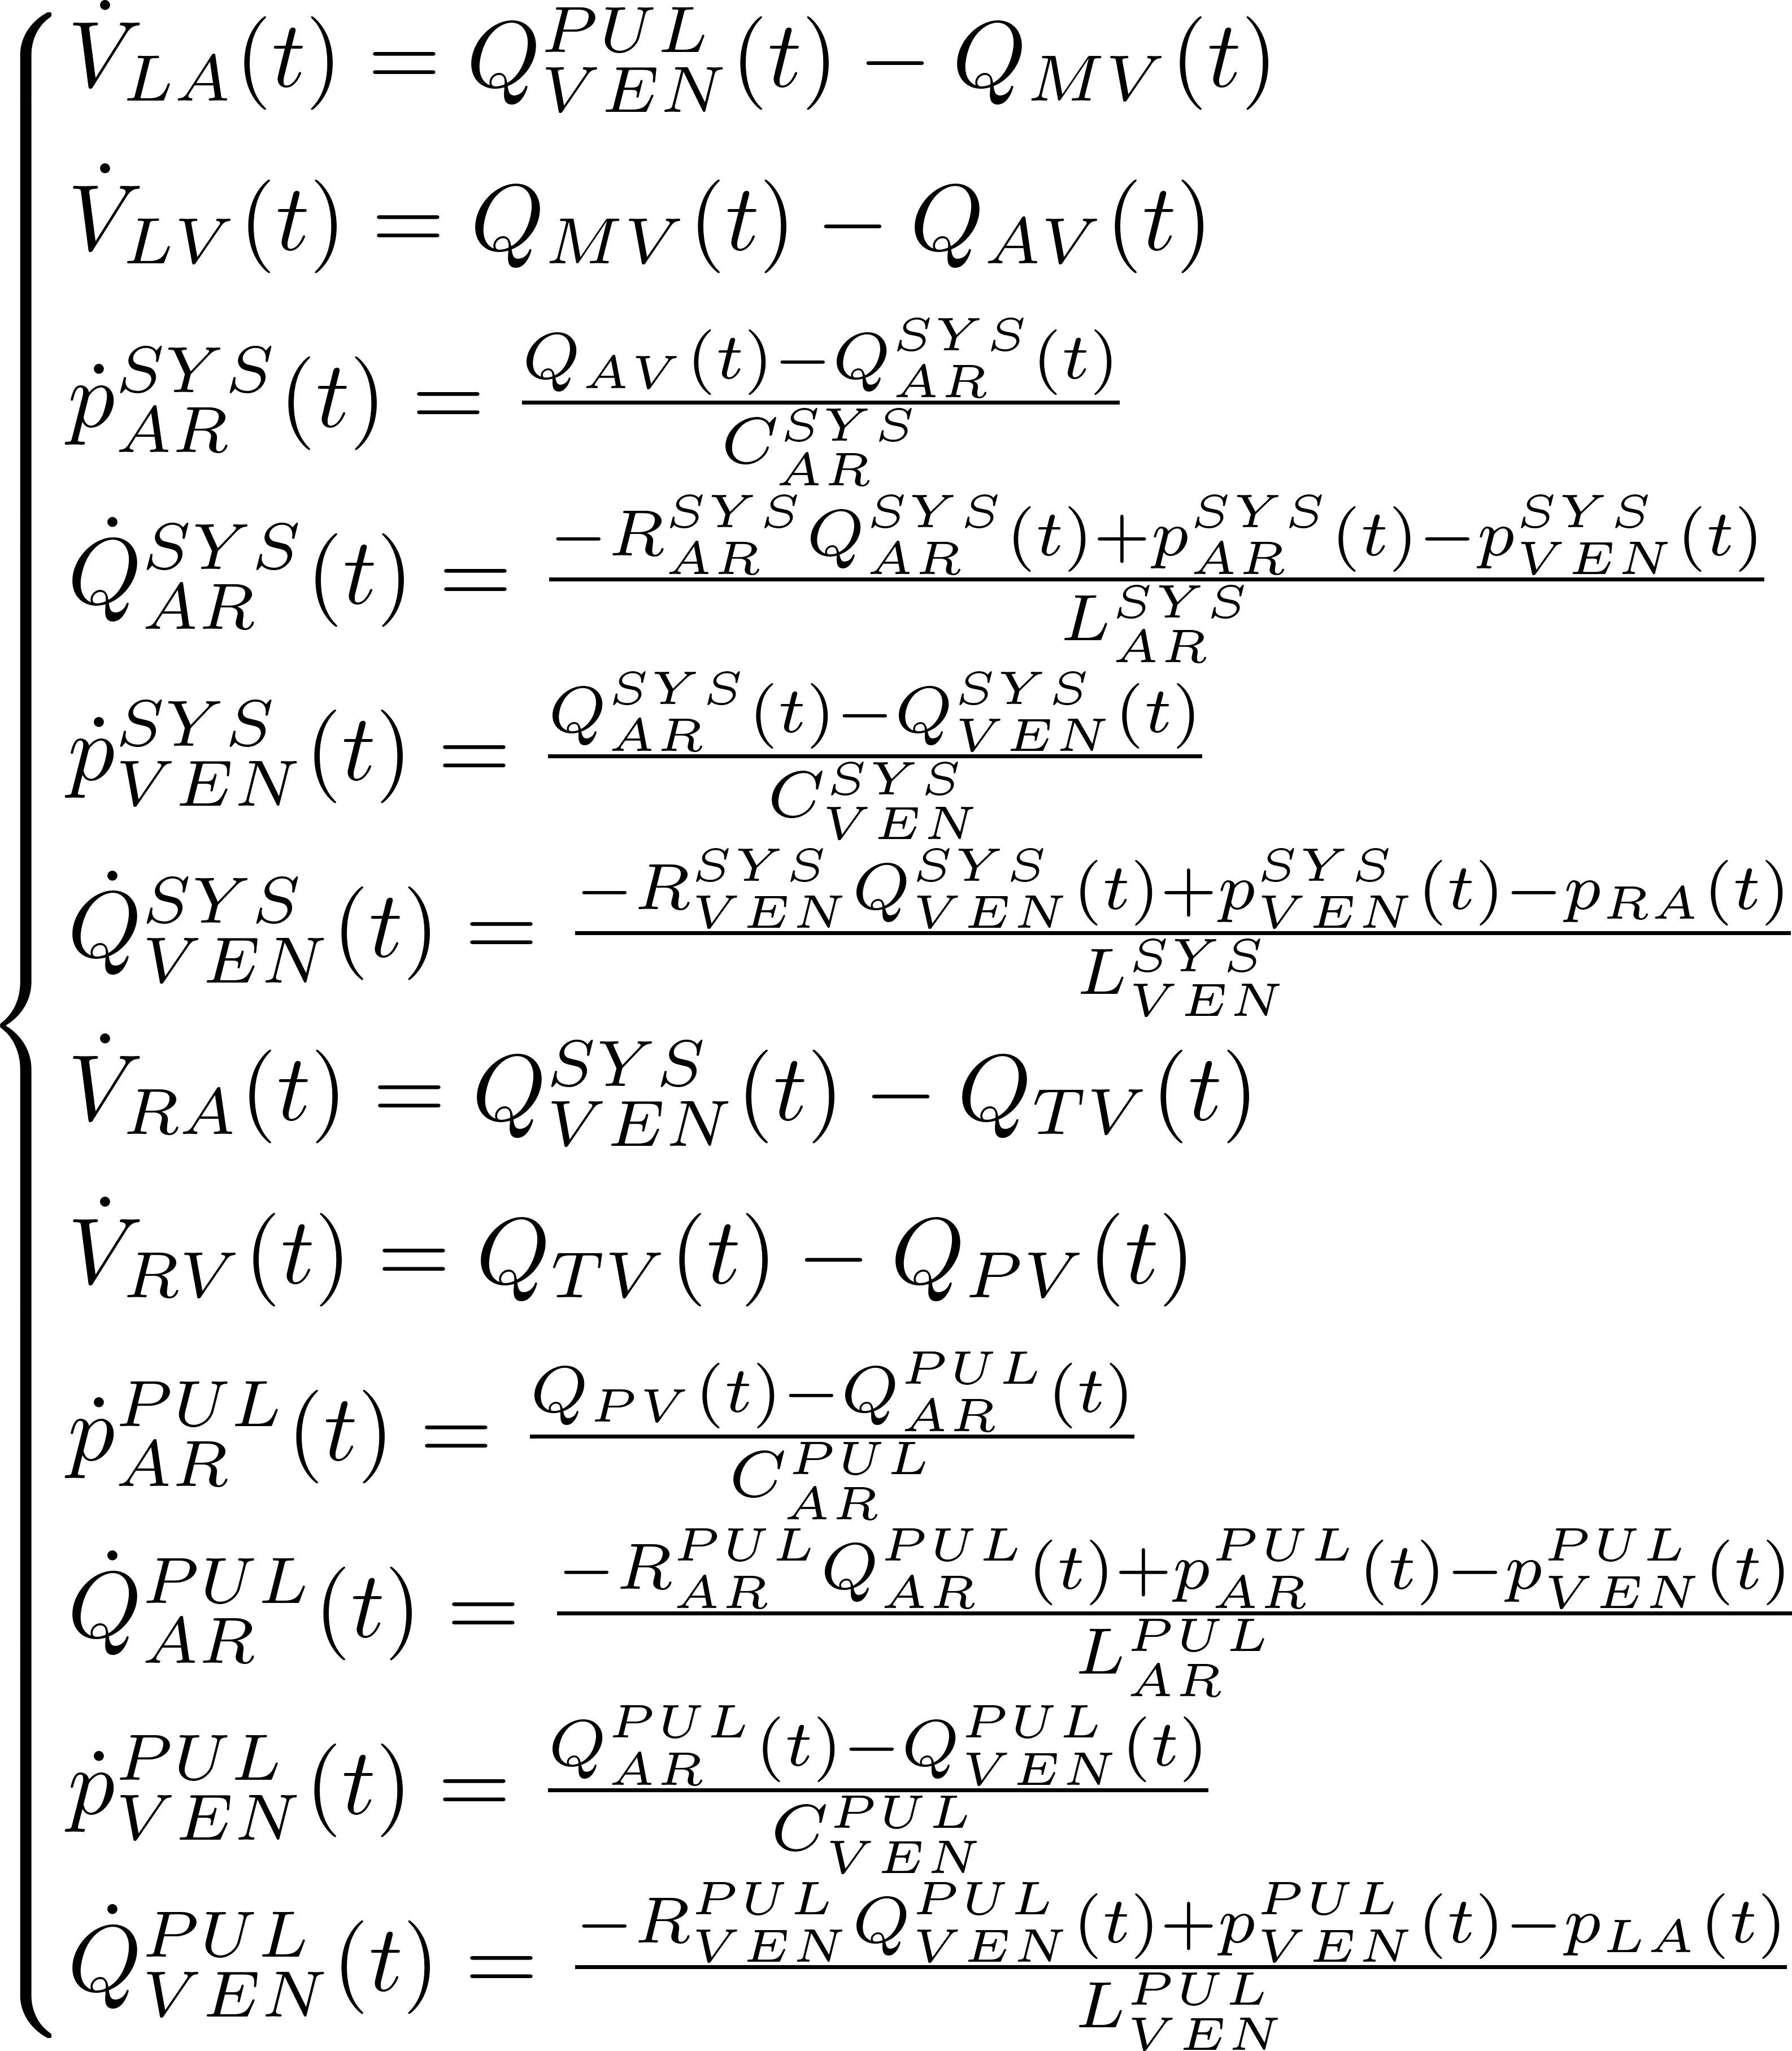
0D circulatory model
Electrical analogy:
Q Flux = current
P Blood pressure
= electric potential
Resistance to blood flow = electric resistance
Vessel compliance
= capacitance
Blood inertia
= inductance
Regazzoni, F. et al. (2022)

Slide 12



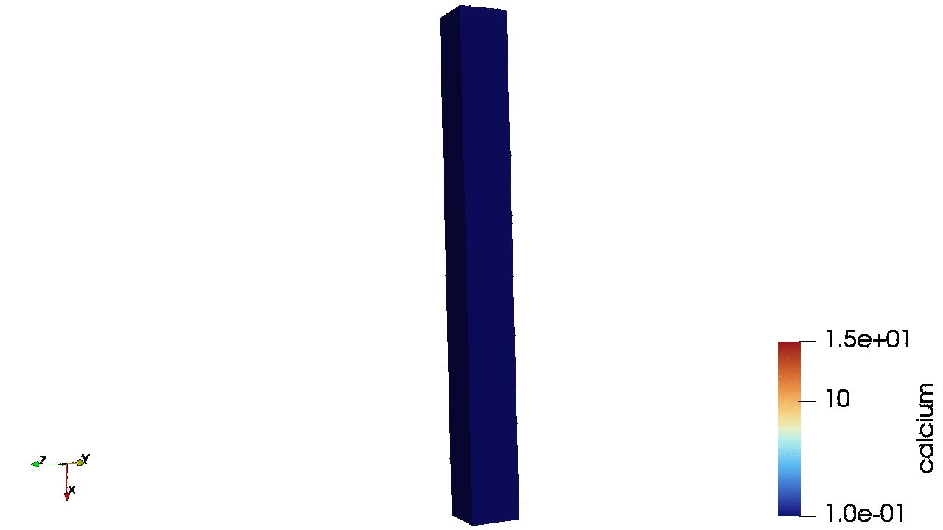


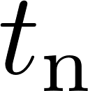
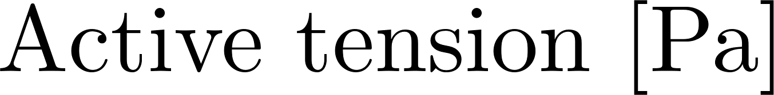


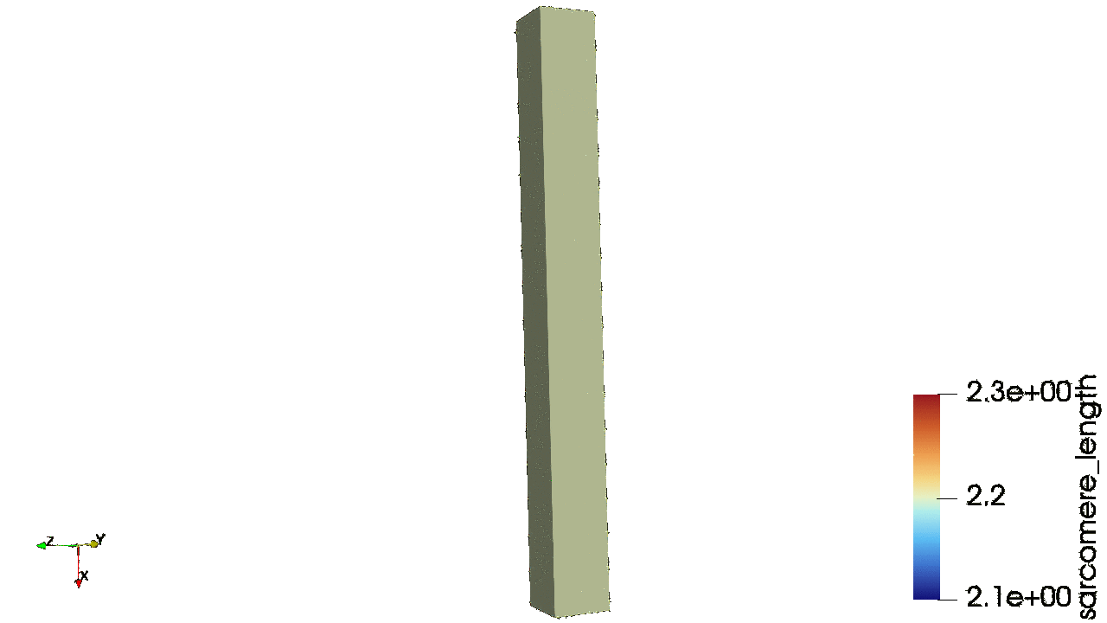

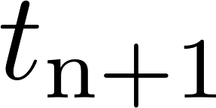
Current status of matrix-free electromechanics solver
Chambers
pressure
Chambers
volume
Strains
Chambers
pressure

Slide 13
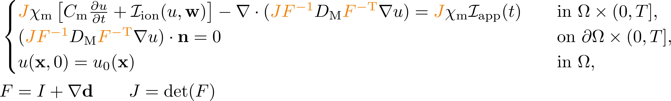
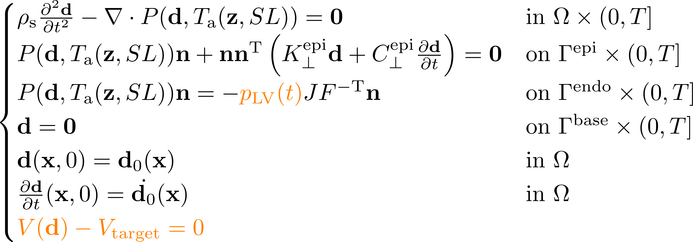
Missing blocks for the electromechanical model
Mechanical feedback to the monodomain model
Coupling of circulation and mechanics
Divergence theorem
Circulation output

Slide 14
Poromechanics model

Slide 15
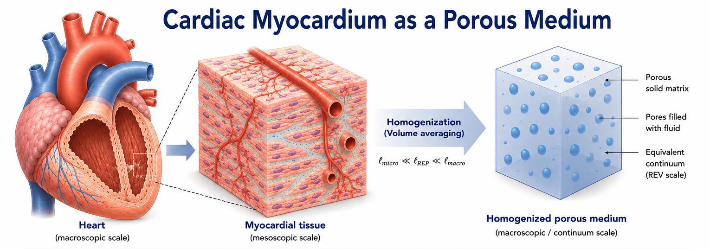
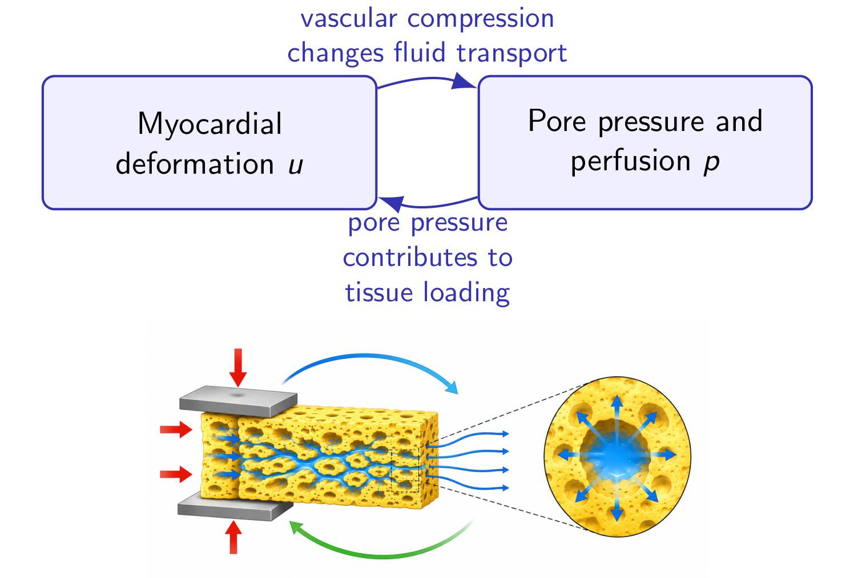
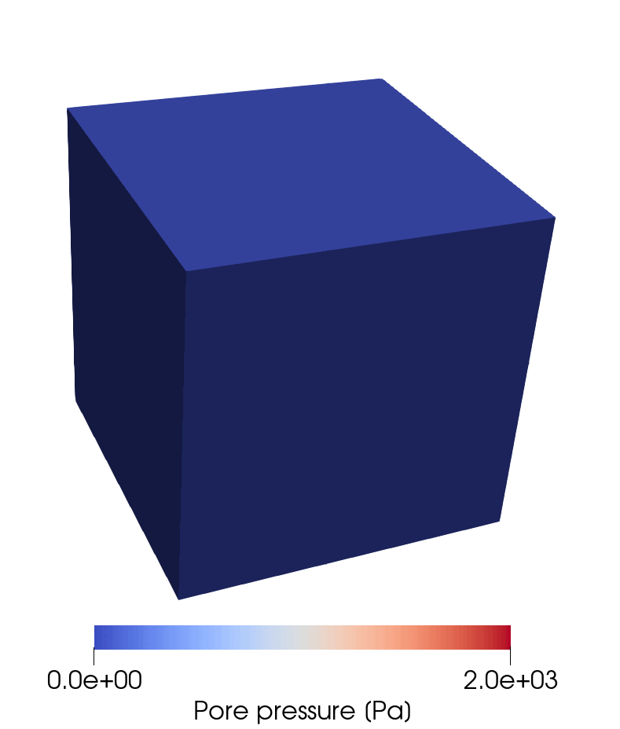
Poromechanics

Slide 16
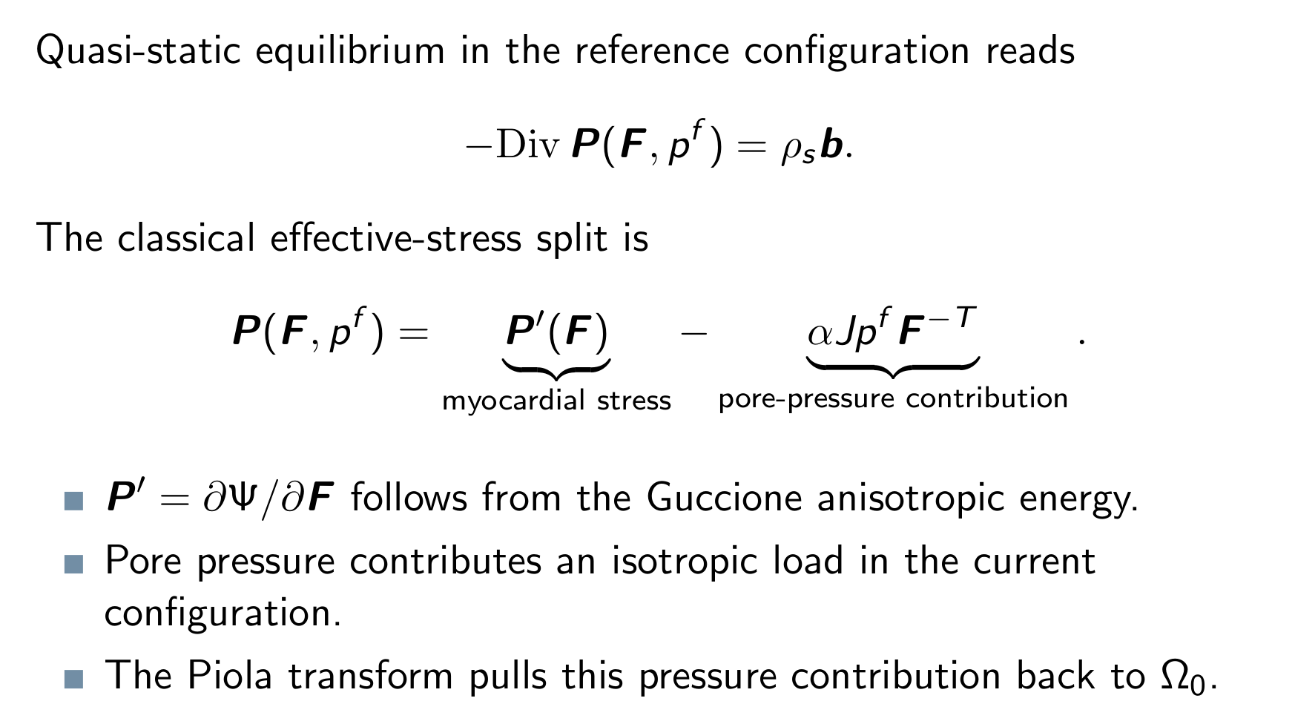
Poromechanical Model

Slide 17
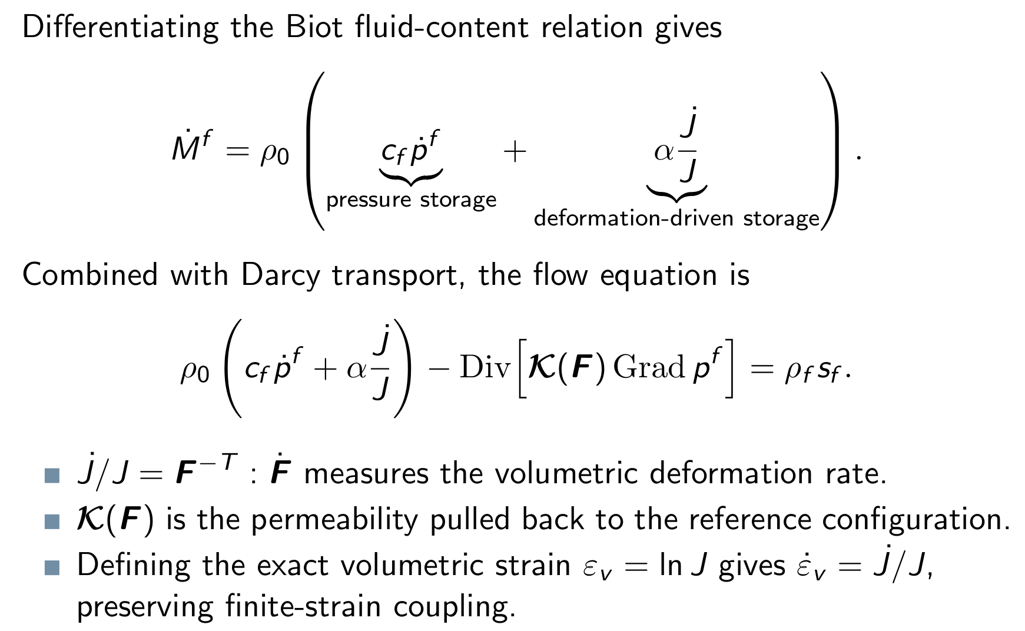
Poromechanical Model

Slide 18
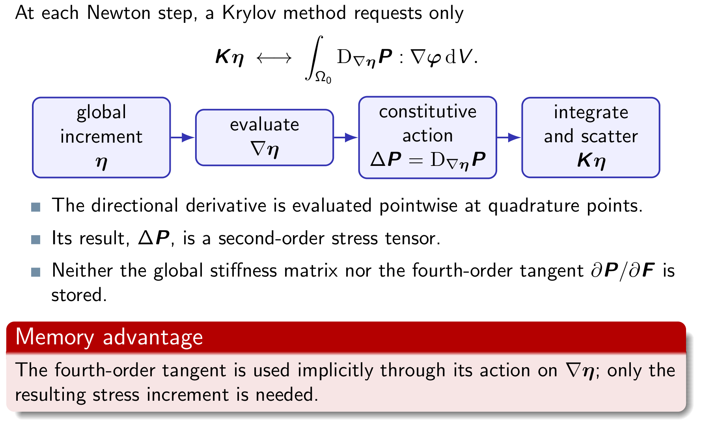
Poromechanical Model

Slide 19
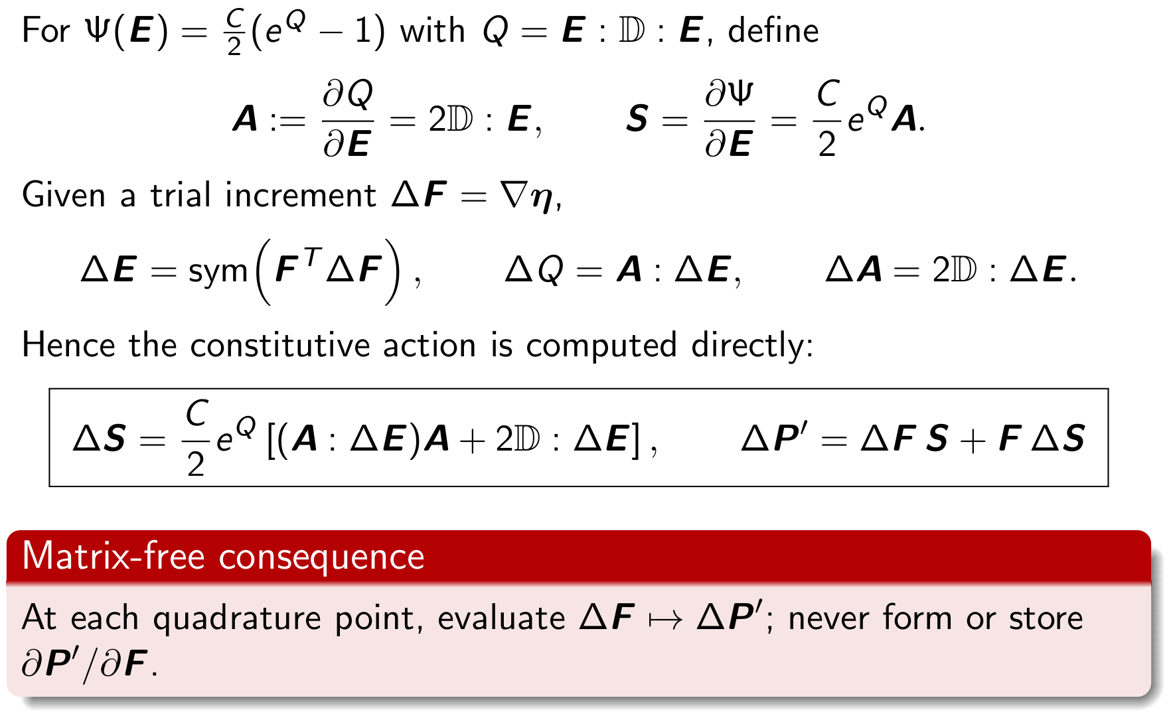
Poromechanical Model

Slide 20
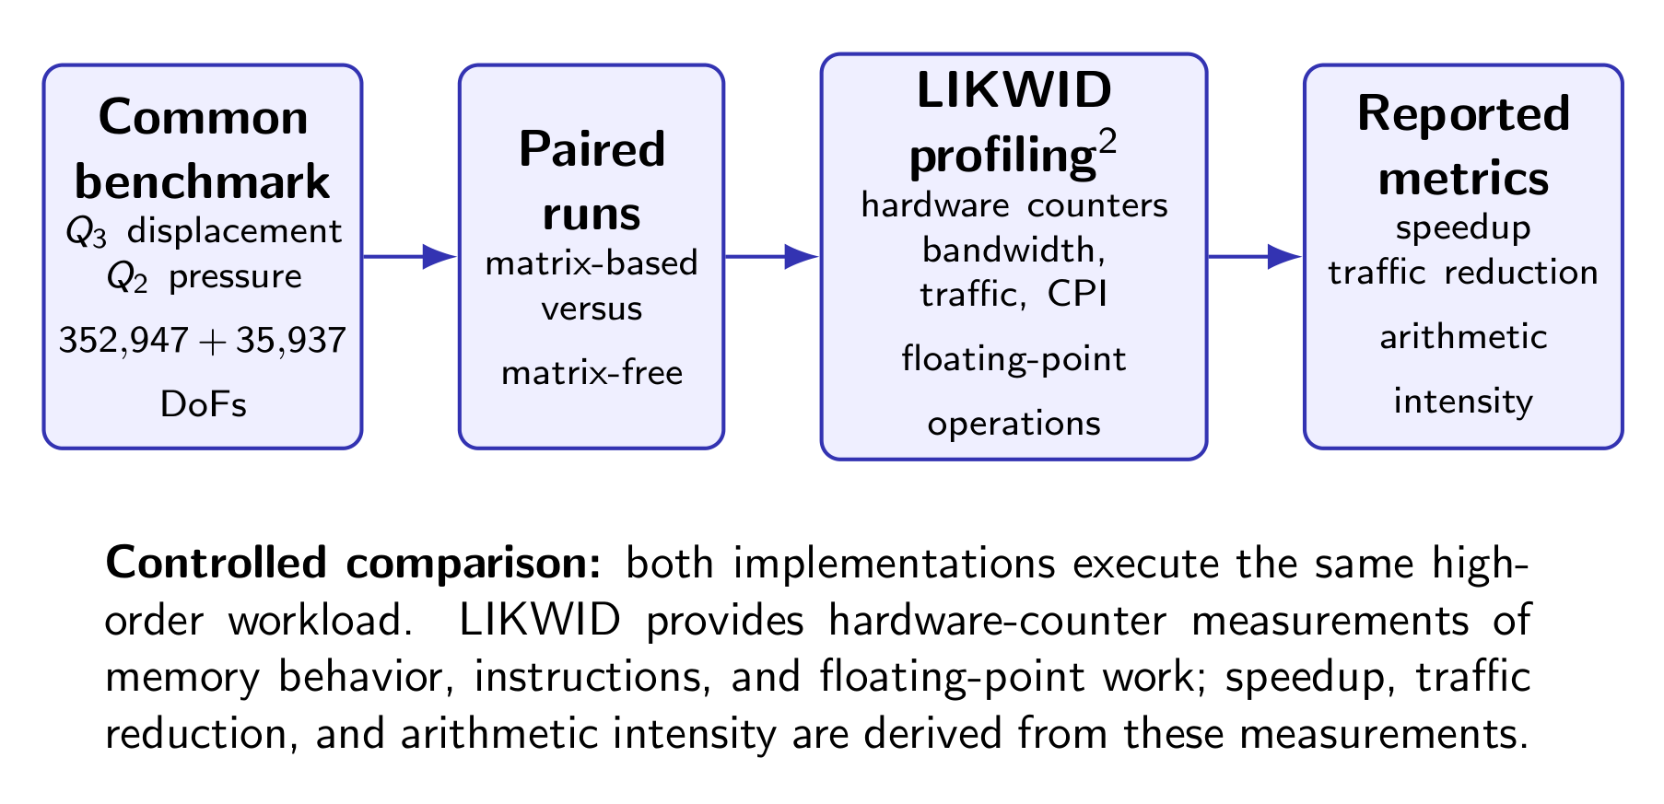
Poromechanical Model

Slide 21
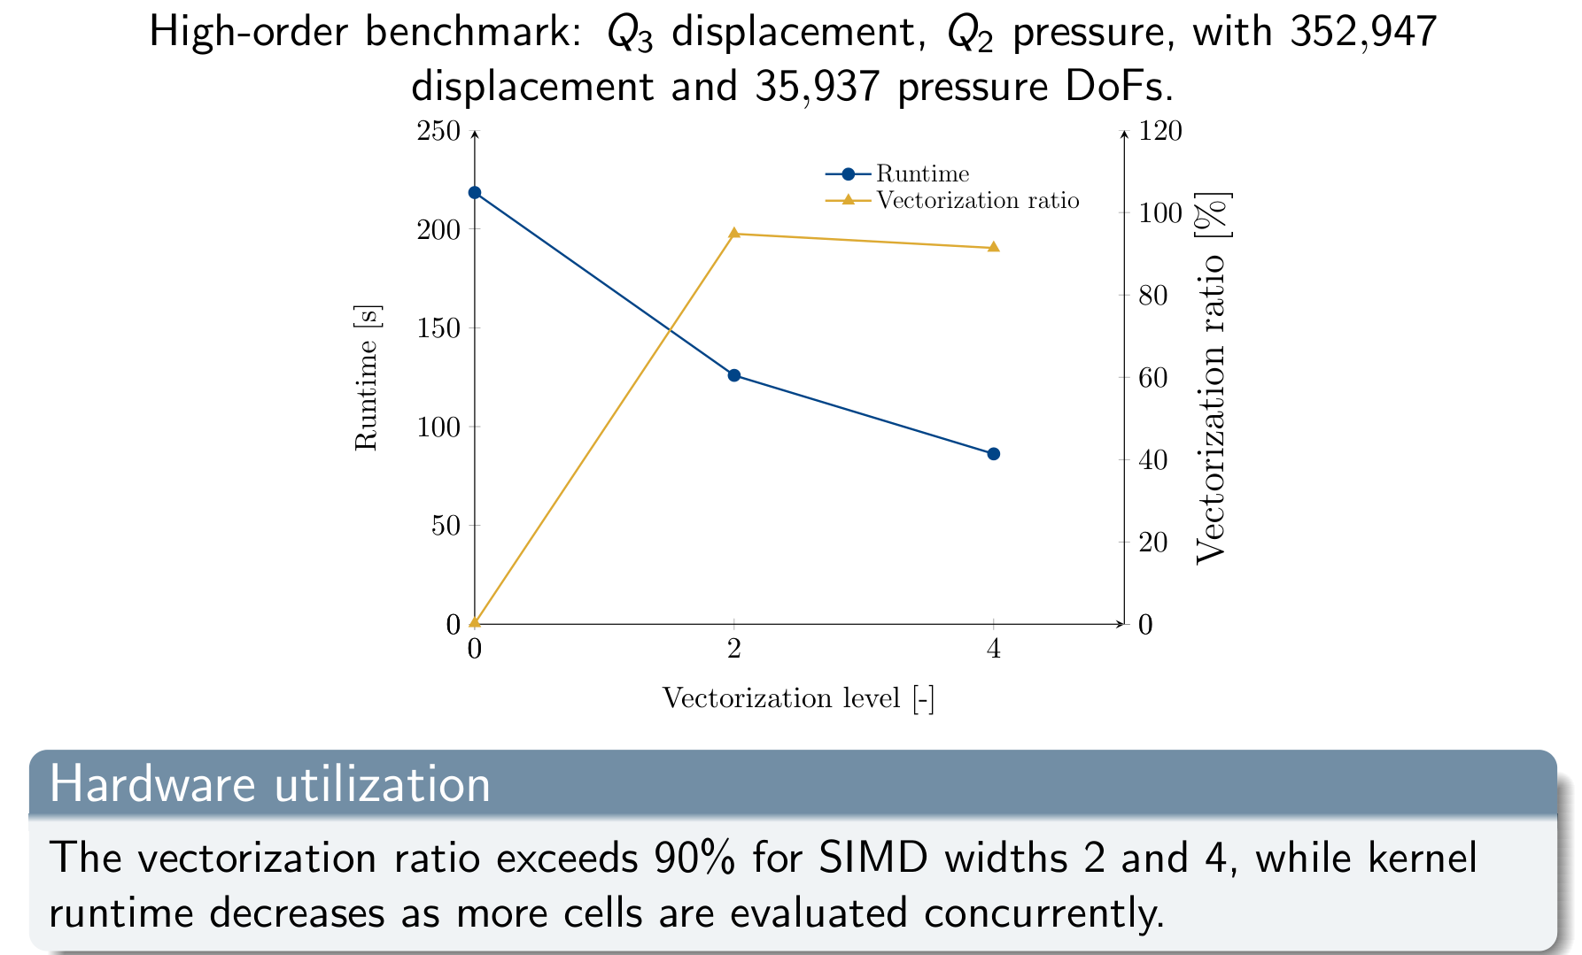
Poromechanical Model

Slide 22
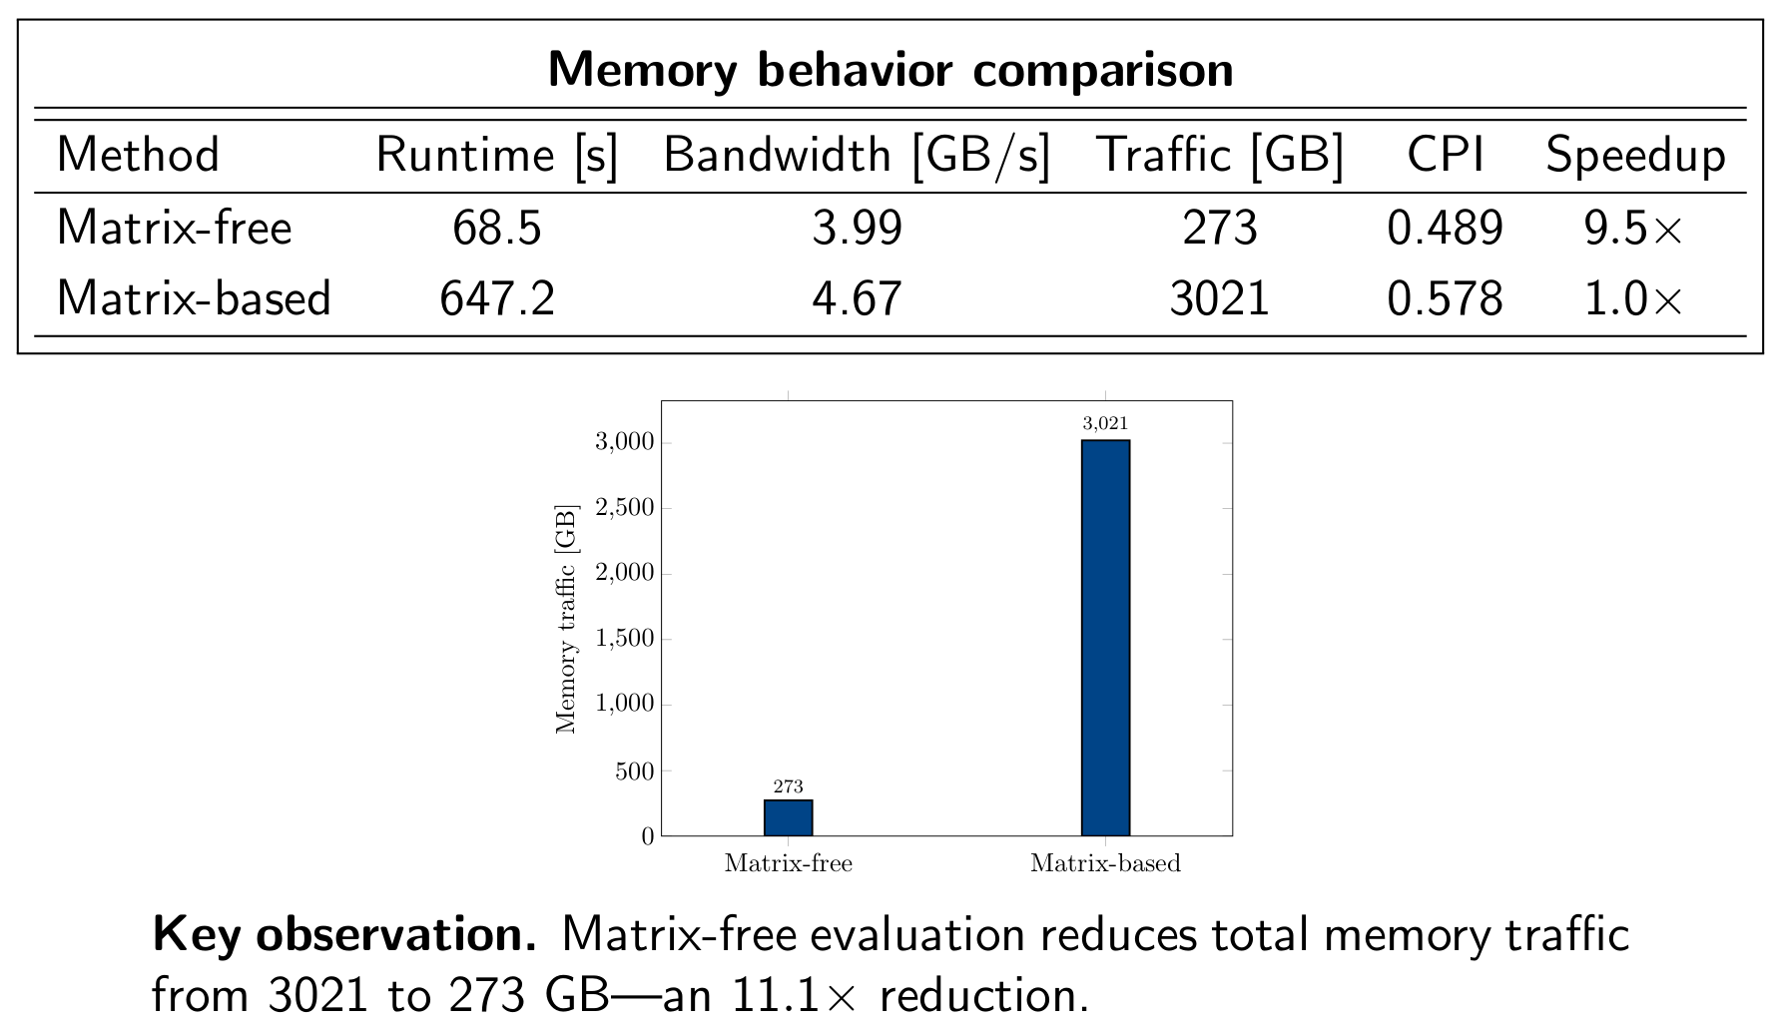
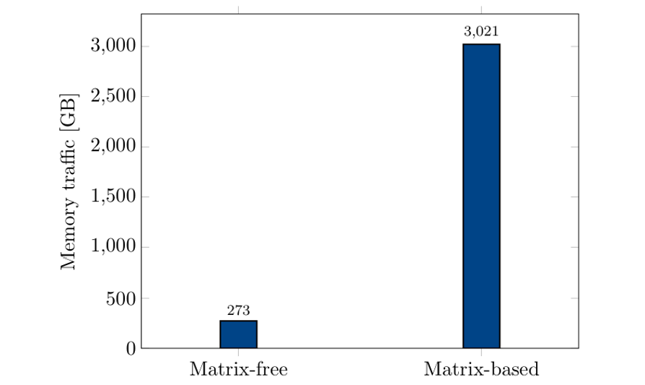
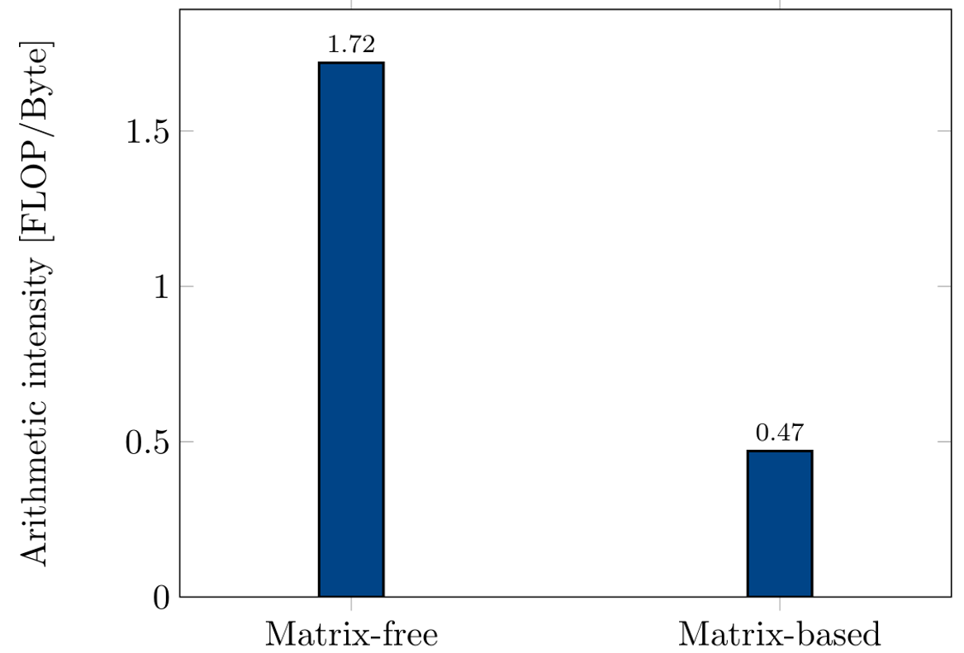
Poromechanical Model

Slide 23
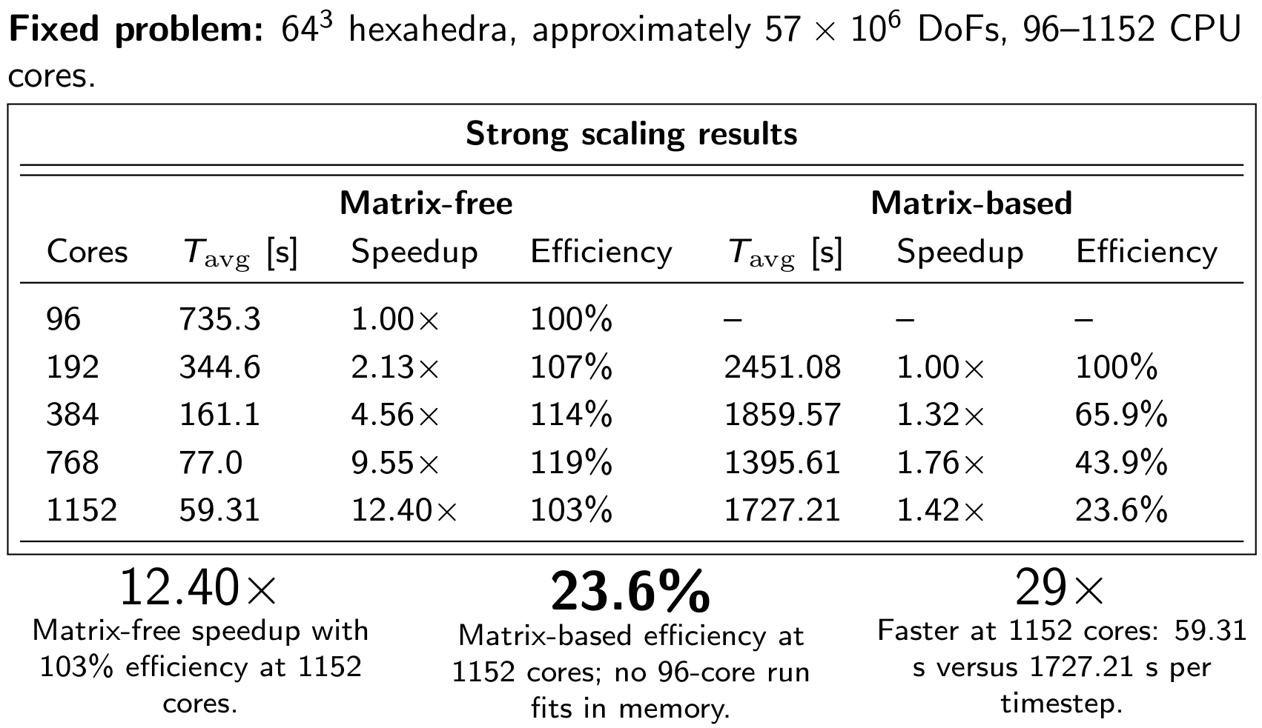
Poromechanical Model

Slide 24
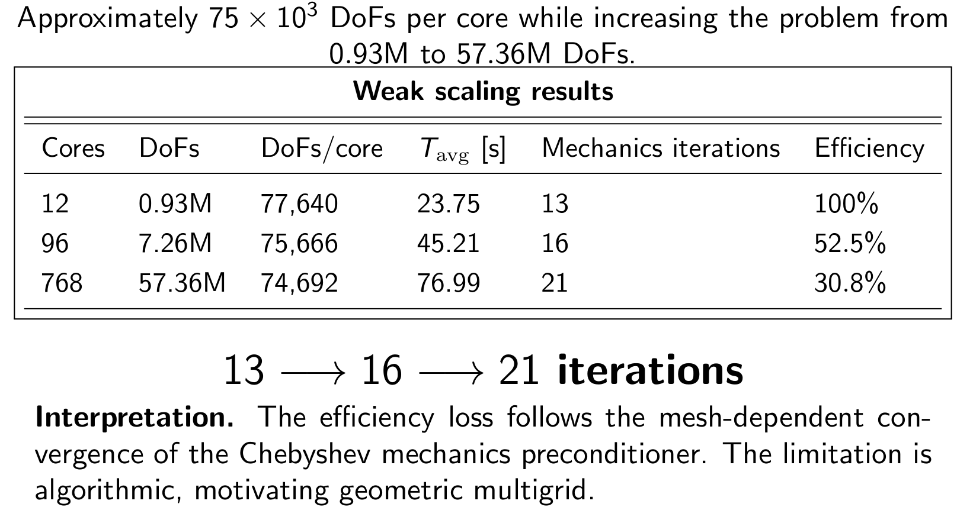
Poromechanical Model

Slide 25
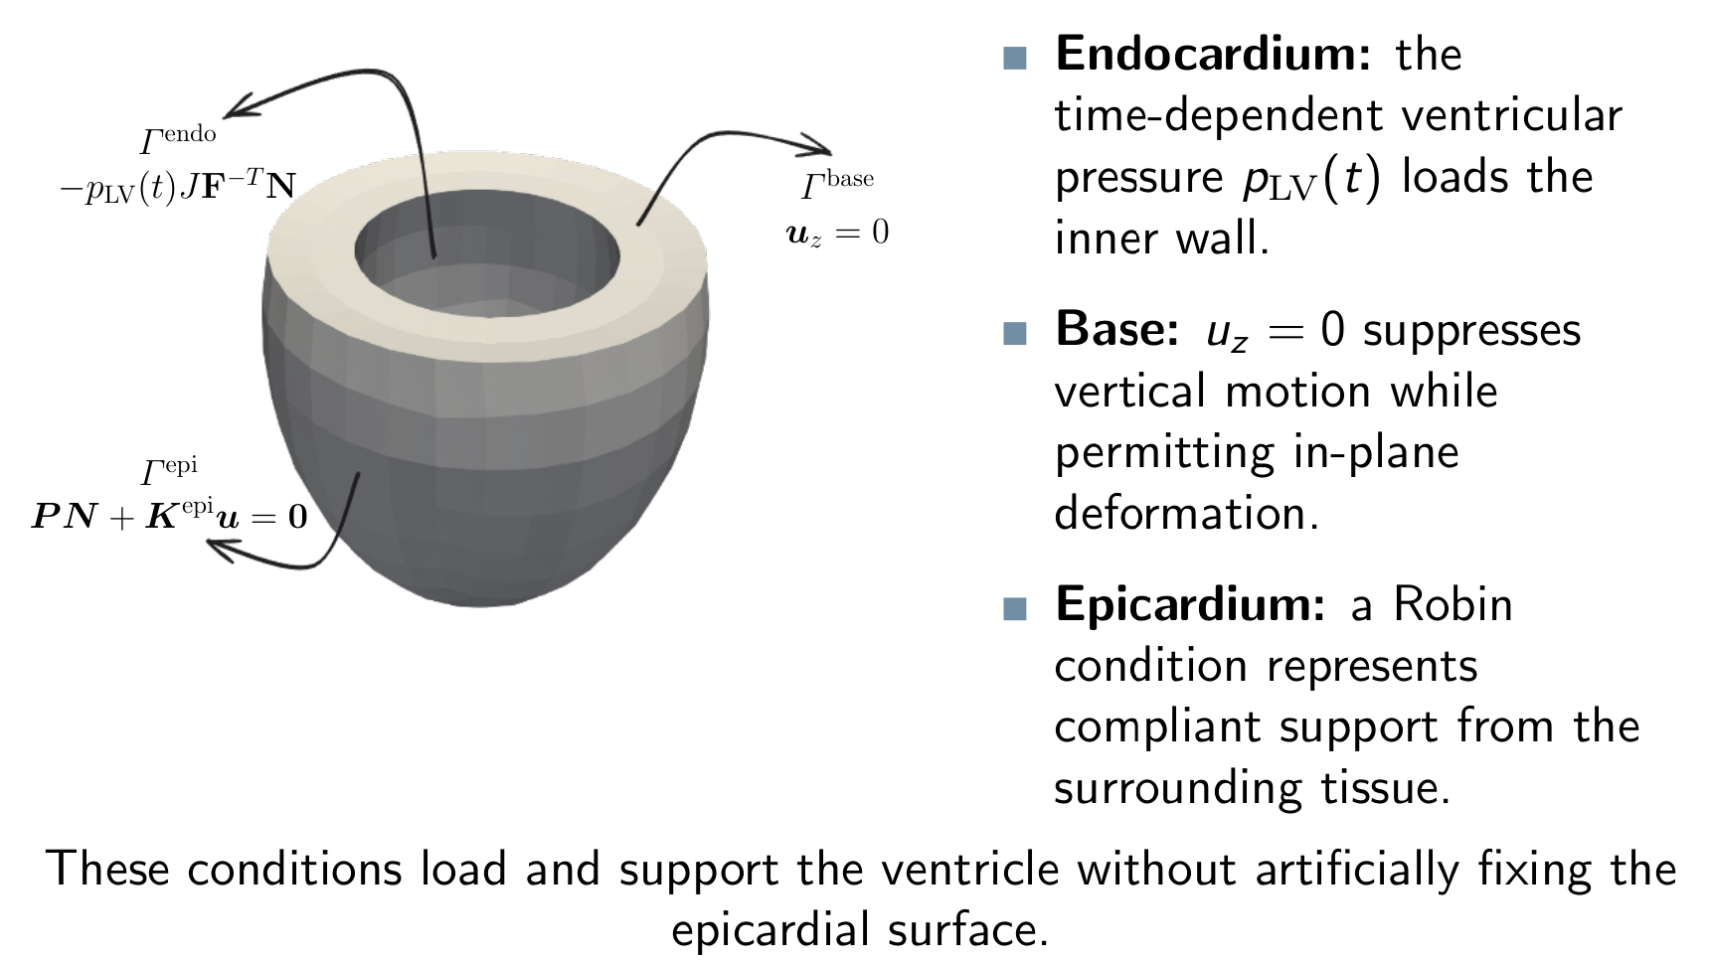
Poromechanical Model

Slide 26
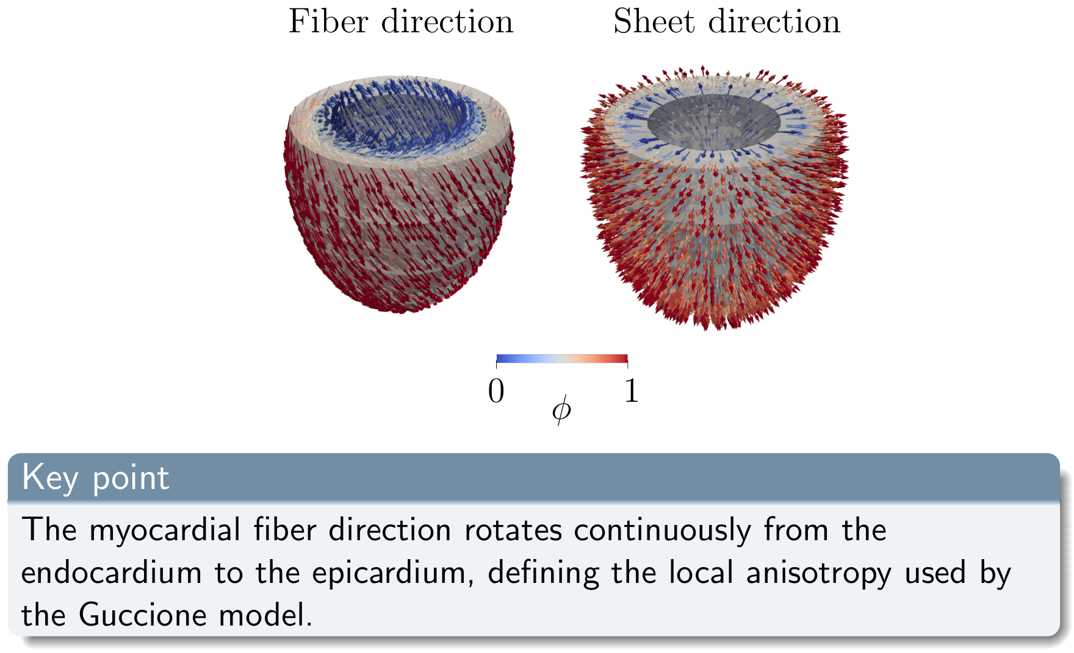
Poromechanical Model

Slide 27
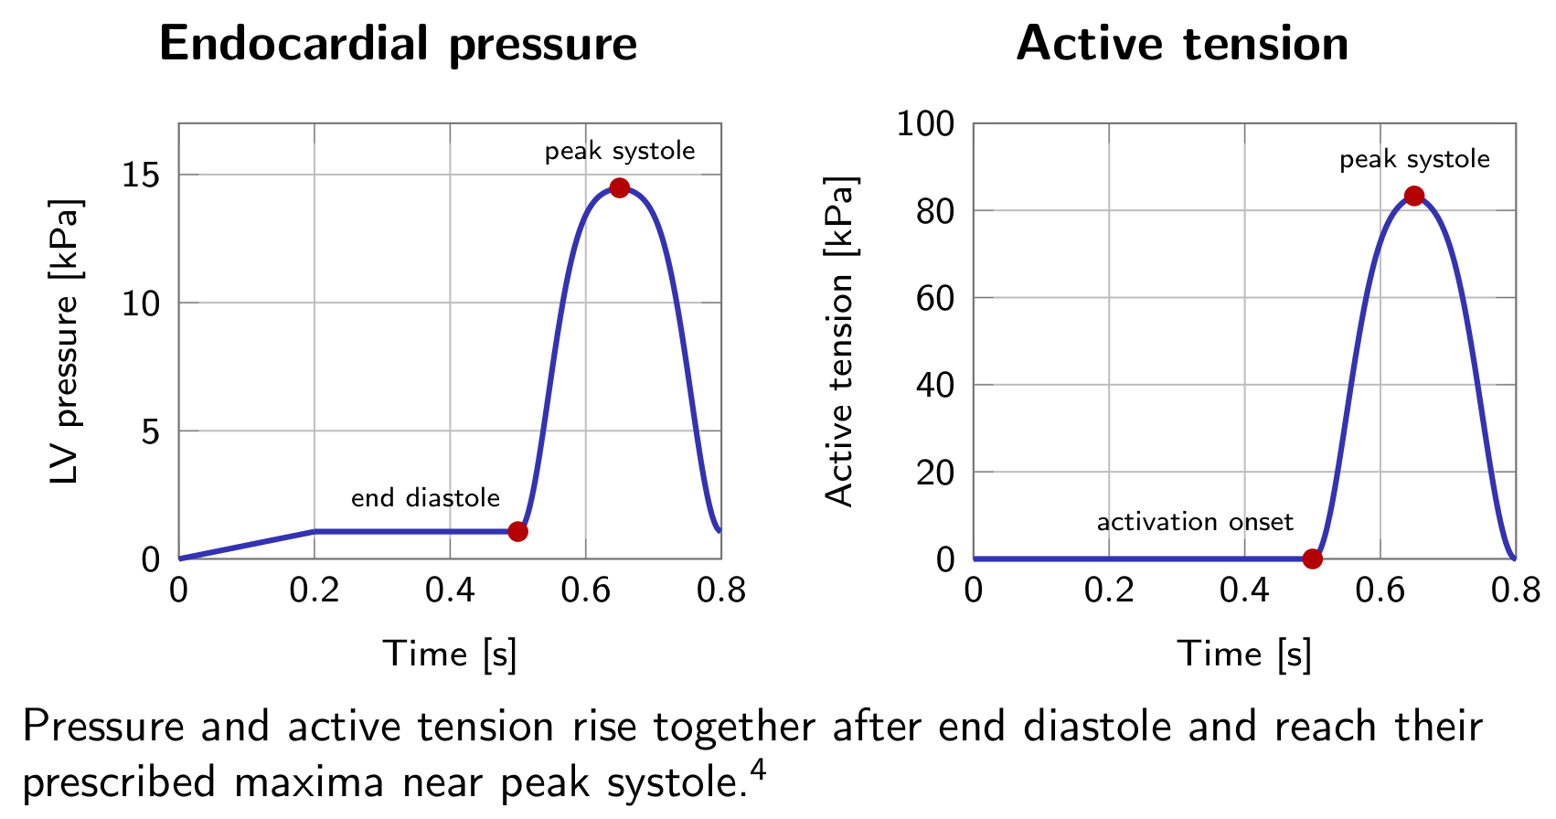
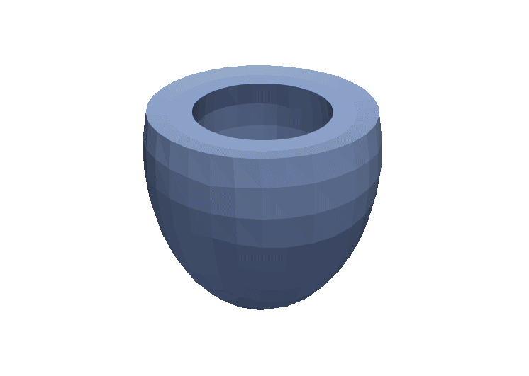
Poromechanical Model

Slide 28
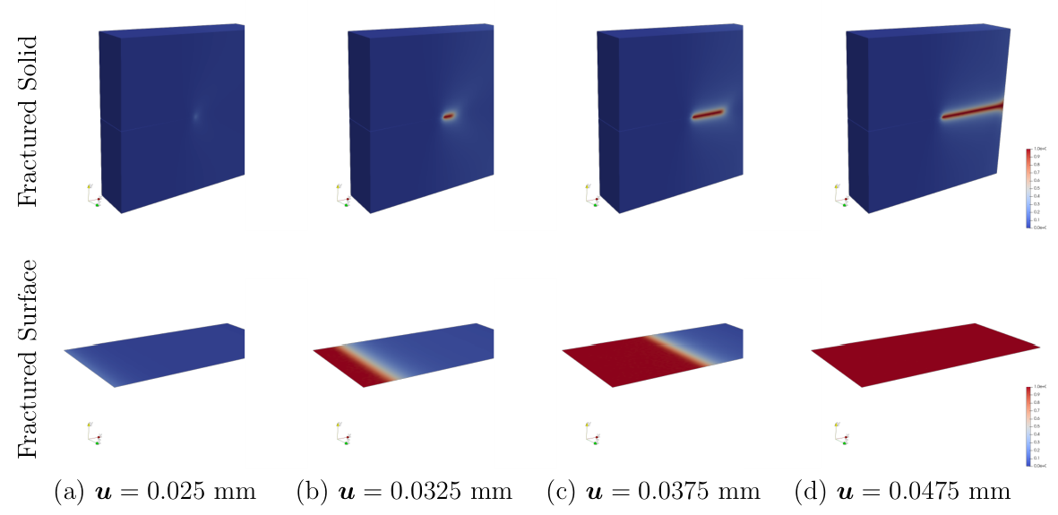
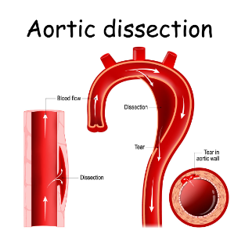
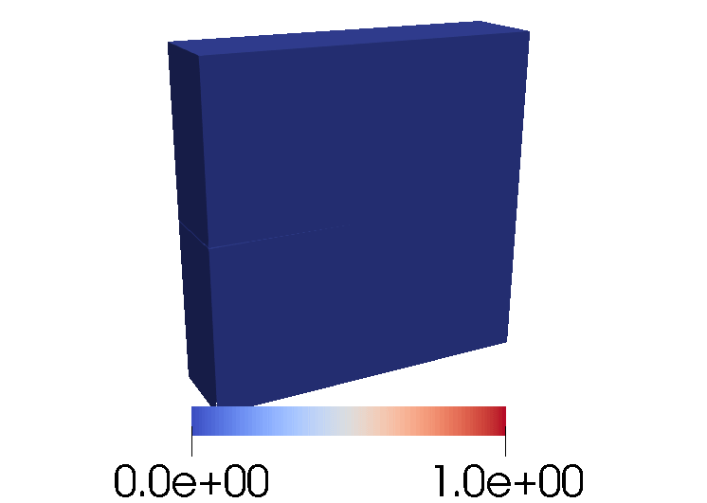
Poromechanical Model

Slide 29
Conclusions and future developments
Conclusions
Matrix-free algorithms provided improvements in the wall time for high polynomial degrees with respect to matrix-based approaches for electrophysiology and mechanical simulations
Matrix-free algorithms exhibit almost ideal strong scalability in pre-exascale frameworks for electrophysiology and mechanical simulations
Fixed-stress splitting gives a stable route to matrix-free coupled poromechanics perfusion.
Future developments
Coupling of the mechanical model with a 0D circulation model to prescribe pressure boundary conditions at the endocardium
Implementation of a mechanical feedback to the electrophysiology model to account for fiber deformation in the conductivity tensor
Scalability tests for electromechanics
Couple electrophysiology, mechanics and perfusion

Slide 30
References
M. Kronbichler, and K. Kormann, A generic interface for parallel cell-based finite element operator application, Computers and Fluids, 63 (2012), pp. 135-147.
M. Fedele, R. Piersanti, F. Regazzoni, M. Salvador, P. C. Africa, M. Bucelli, A. Zingaro, and A. Quarteroni, A comprehensive and biophysically detailed computational model of the whole human heart electromechanics, Computer Methods in Applied Mechanics and Engineering, 410 (2023), p. 115983.
M. Potse, B. Dube, J. Richer, A. Vinet, and R. M. Gulrajani, A comparison of monodomain and bidomain reaction-diffusion models for action potential propagation in the human heart, IEEE Transactions on Biomedical Engineering, 53 (2006), pp. 2425–2435.
K. H. Ten Tusscher and A. V. Panfilov, Alternans and spiral breakup in a human ventricular tissue model, American Journal of Physiology-Heart and Circulatory Physiology, 291 (2006), pp. H1088–H1100.
J. M. Guccione and A. D. McCulloch, Finite element modeling of ventricular mechanics, Springer, New York, NY, 1991, pp. 121–144.
F. Regazzoni, L. Dede’, and A. Quarteroni, Biophysically detailed mathematical models of multiscale cardiac active mechanics, PLoS computational biology, 16 (2020), p. e1008294.
F. Regazzoni, M. Salvador, P. C. Africa, M. Fedele, L. Dede’, and A. Quarteroni, A cardiac electromechanical model coupled with a lumpedparameter model for closed-loop blood circulation, Journal of Computational Physics, 457 (2022), p. 111083.

